Slide 1
Query to Knowledge
Unsupervised Entity Extraction from Shopping Queries using Adaptor Grammars
Ke Zhai
Yahoo Labs!

Slide 2
Outline
Query to Knowledge (SIGIR 2016)
Motivation – Query to Knowledge
Model – Adaptor Grammar
Framework Pipeline
Empirical Evaluation
Conclusion
Other Research Highlights

Slide 3
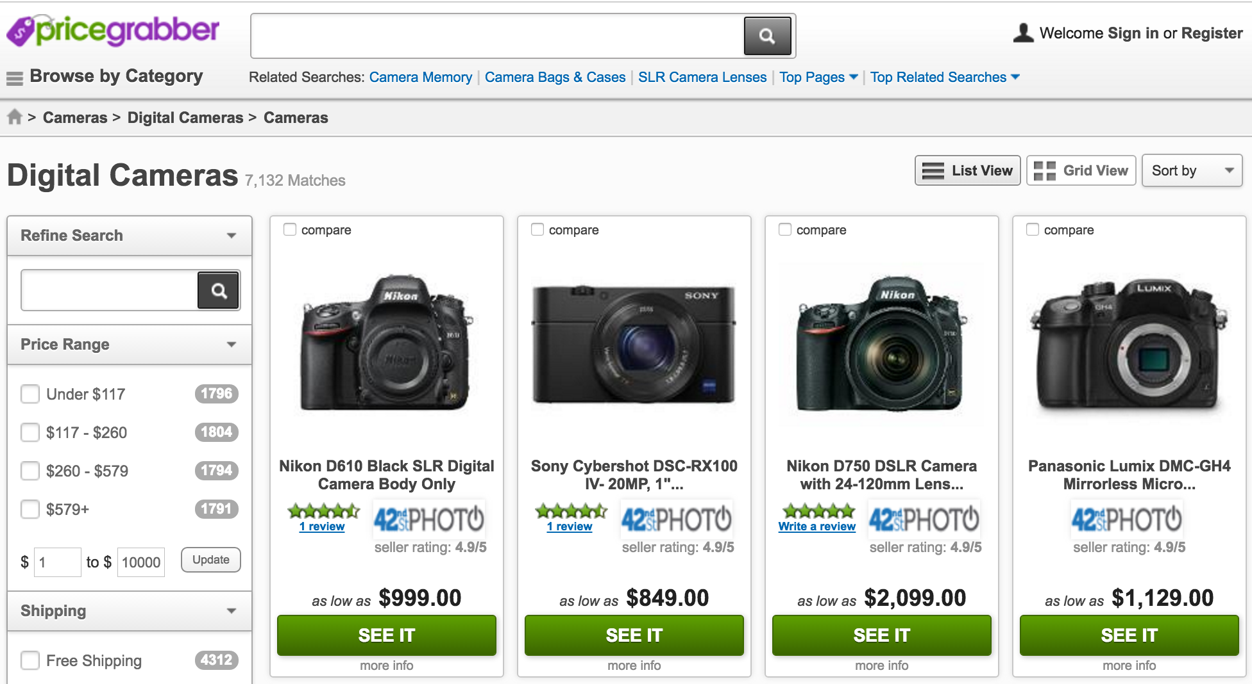
Knowledgebase for Shopping
Knowledgebase is critical
Entity linking
Search ranking
Query understanding
User intent modeling
Assistant chat bot
…
In this work…
Targeting at shopping domain
Brand and product entities
Knowledgebase is expensive
Build
Maintain
Notes:
Knowledgebase is critical for Yahoo’s business.
It is useful for many tasks, including entity linking, query understanding, user intent modeling and now-a-days assistant chat bot technologies.
In this work, we are especially targeting on building the knowledgebase for online shopping domain, specifically about the brand entities and product entities.
Building a knowledgebase are very expensive to get.
One team in Yahoo has crawled all the websites under pricegrabber.com, and also tried to build a shopping entity knowledgebase out of it, with human labeling and some statistical ranking method.
But it does not work well.
In addition, such knowledgebase can be difficult to maintain, since brand and product are constantly changing and innovating.

Slide 4


Motivation
too faced chocolate soleil bronzer
calvin klein brown tote bag
nikon d3000 digital camera
sally hansen miracle gel
fitbit flex wireless activity sleep wristband
john deere garden tractor
bag boy golf cart accessories
michael kors tote bag
kohler toilet paper holders
calvin klein underwear
…
too faced chocolate soleil bronzer
calvin klein brown tote bag
nikon d3000 digital camera
sally hansen miracle gel
fitbit flex wireless activity sleep wristband
john deere garden tractor
bag boy golf cart accessories
michael kors tote bag
kohler toilet paper holders
calvin klein underwear
…
Brand | Product
too faced | bronzer
calvin klein | tote bag
nikon | digital camera
sally hansen | miracle gel
fitbit | sleep wristband
john deere | garden tractor
bag boy | golf cart accessories
michael kors | toilet paper holders
kohler | underwear
… | …
Notes:
The motivation of this work is to build a brand and product knowledgebase out of the gigantic amount of queries we collected from the search engine.
For example, in this case, we are given a collection of online search queries, and we want to extract these brand and product entities from the query logs.
As a human being, one clue is to look at the co-occurrences among different word tokens as well as some internal parse structure of the user query.

Slide 5


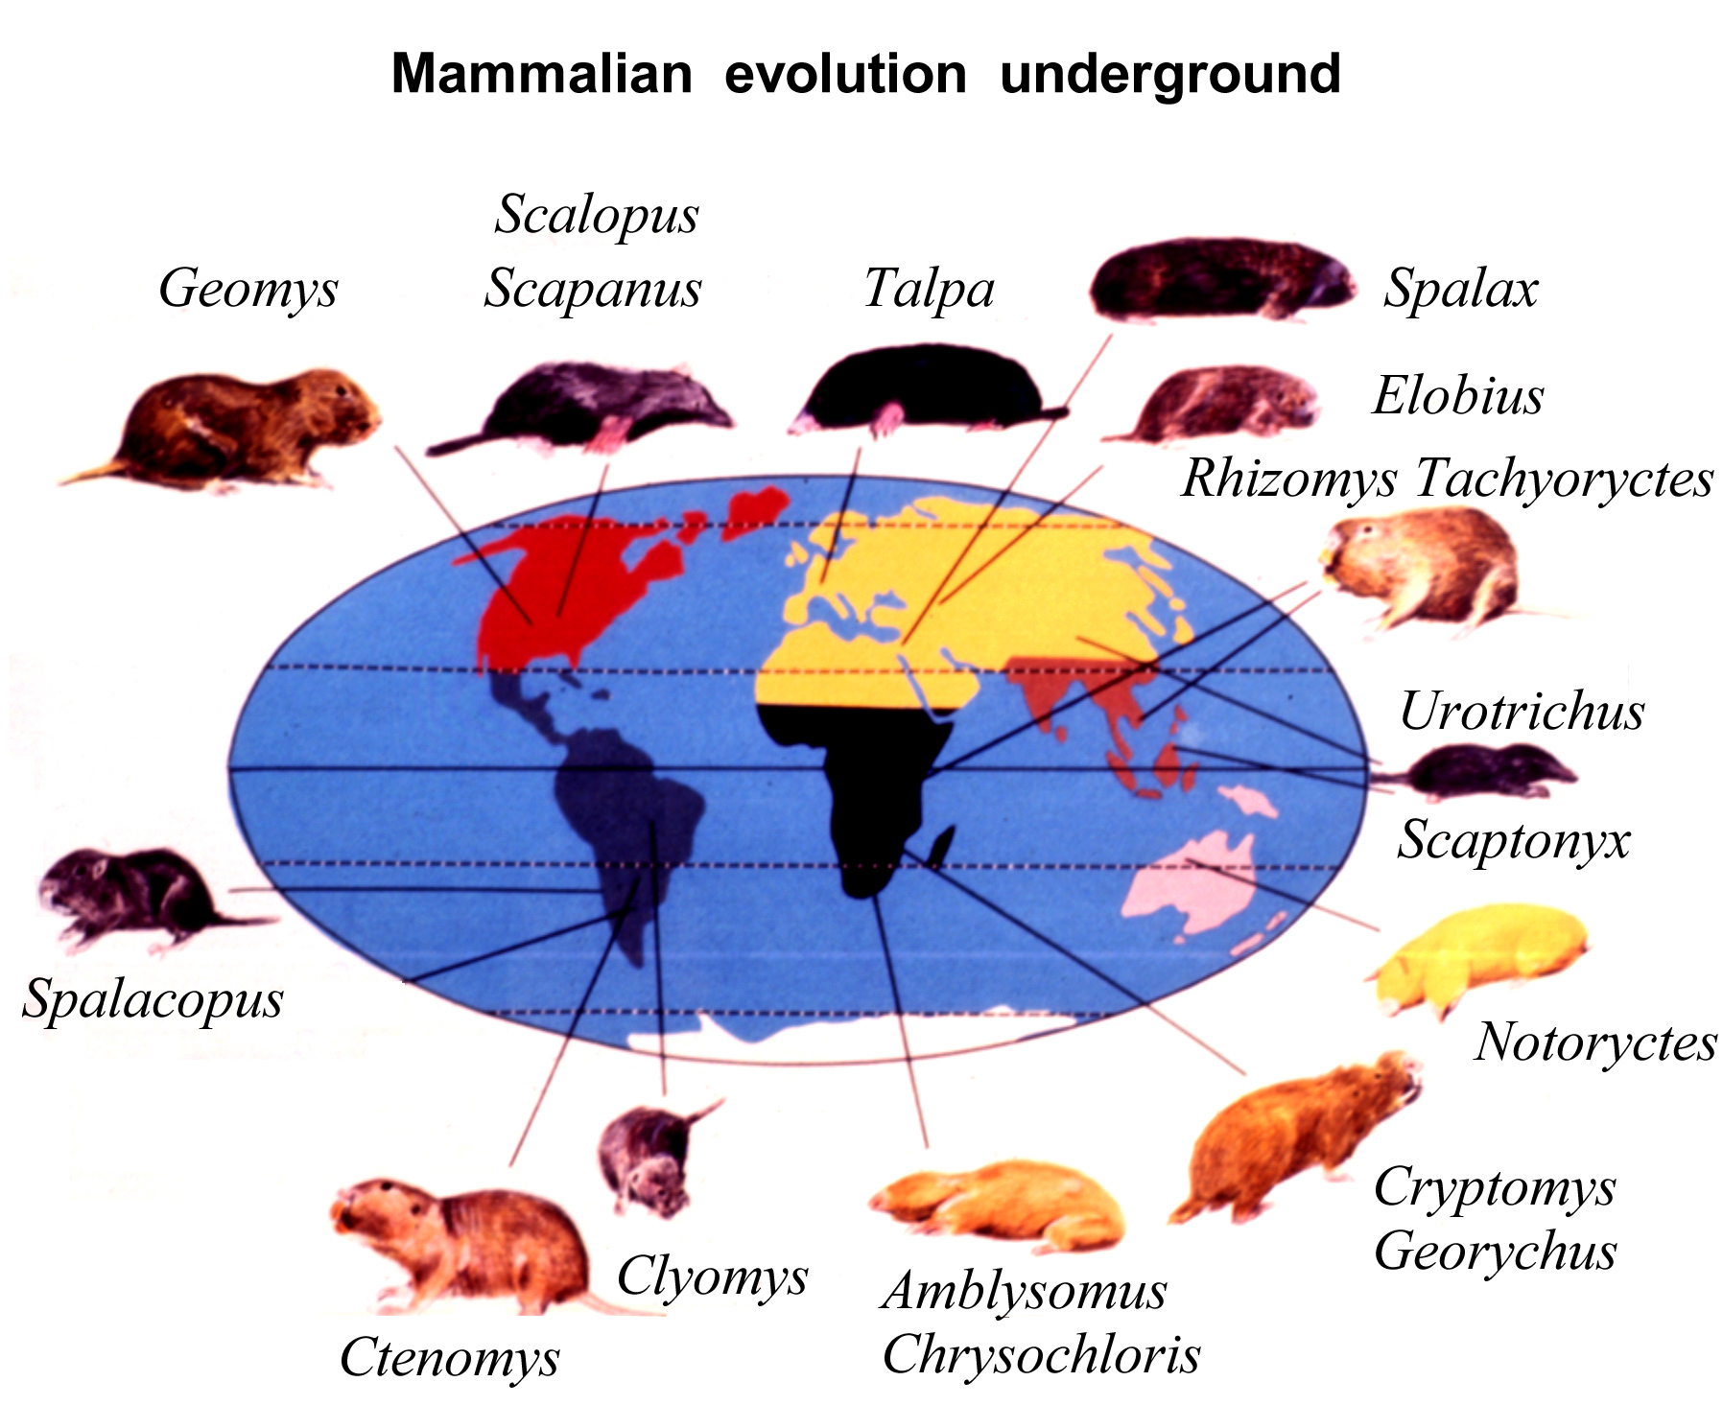

Goals
Unsupervised
Minimum human efforts in the loop
No editorial labeling nor annotation
Robust
Effectively model the data and robust to noise commonly appeared in large scale web query dataset
Domain-independent
Applicable to multiple domains with minimum adaptation efforts
Data-driven
Numbers and granularities of brand and product are not known a priori
Discover more/new brand and product given additional data
Context-free (Domain-independent)
Grammar (Unsupervised)
Probabilistic (Robust)
Non-parametric (Data-driven)
Adaptor Grammar
Notes:
And that is exactly what we want to do.
We want our framework to be unsupervised, which requires minimum human efforts in the loop.
In addition, we want our framework to be robust to noise commonly appeared in user search queries, including typos and ordering permutations.
We also want our model to be generalizable to multiple shopping domains, such as Apparel, Electronics.
Last but not least, we want our model to be data-driven and non-parametric. Since in many cases, we do not know how many brands and products existed in a domain a priori, and we want to let the data to decide it.
Combining all these factors together, we want to utilize the linguistic grammar property, with the probabilistic context-free modeling to deal with noise and domain-specific contents.
In addition to that, we impose a non-parametric probabilistic prior to enforce our model to be data-driven.
The model we are looking for is a non-parametric probabilistic context-free grammar, also known as the adaptor grammar.

Slide 6
Probabilistic Context-free Grammar
Query
Brand
Words
Word
pottery
Words
Word
barn
Product
Words
Word
coffee
Words
Word
table
pottery barn coffee table
Prob | Rule
1.0 | Query → Brand Product
1.0 | Brand → Words
1.0 | Product → Words
0.5 | Words → Word Words
0.5 | Words → Word
0.1 | Word → pottery
0.1 | Word → barn
0.1 | Word → coffee
0.1 | Word → table
… | …
Prob | Rule
1.0 | Query → Brand Product
1.0 | Brand → Words
1.0 | Product → Words
0.7 | Words → Word Words
0.3 | Words → Word
0.2 | Word → pottery
0.2 | Word → barn
0.07 | Word → coffee
0.07 | Word → table
… | …
Prob | Rule
1.0 | Query → Brand Product
1.0 | Brand → Words
1.0 | Product → Words
0.5 | Words → Word Words
0.5 | Words → Word
0.1 | Word → pottery
0.1 | Word → barn
0.1 | Word → coffee
0.1 | Word → table
… | …
Query
Brand
Words
Word
pottery
Product
Words
Words
Words
Word
chest
Words
Word
barn
Word
drawer
pottery barn drawer chest
Query
Brand
Words
Word
ashley
Words
Word
zelen
Product
Words
Word
drawer
Words
Word
chest
ashley zelen drawer chest
Notes:
Before we jump into adaptor grammar, let us briefly review the probabilistic context-free grammar.
Here, we are given a collection of PCFG rules.
The learning process of PCFG is to infer the rule probability of each grammar rule.
<add explanation to the process>
One disadvantage of PCFG is that the generated subtrees are completely independent from instance to instance.
For example, after you generate the parse trees for instance “pottery barn coffee table”, when you parse the instance “pottery barn drawer chest”, a natural way to do is to reuse the parse trees you already generated for the previous examples.
However, PCFG imposes to much context-freeness assumption, which does not support that.
Every time you parse a new instance, you have to start over and build the parse tree again.

Slide 7
Adaptor Grammar (Johnson et al., 2007)
Query
Brand
Words
Word
pottery
Words
Word
barn
Product
Words
Word
coffee
Words
Word
table
Prob | Rule
1.0 | Query → Brand Product
1.0 | Brand → Words
1.0 | Product → Words
0.7 | Words → Word Words
0.3 | Words → Word
0.1 | Word → pottery
0.1 | Word → barn
0.2 | Word → coffee
0.2 | Word → table
 | …
Prob | Rule
1.0 | Query → Brand Product
0.81 | Brand → Words
0.75 | Product → Words
0.7 | Words → Word Words
0.3 | Words → Word
0.1 | Word → pottery
0.1 | Word → barn
0.2 | Word → coffee
0.2 | Word → table
 | …
0.19 | Brand → pottery barn
0.25 | Product → coffee table
Prob | Rule
1.0 | Query → Brand Product
1.0 | Brand → Words
1.0 | Product → Words
0.7 | Words → Word Words
0.3 | Words → Word
0.1 | Word → pottery
0.1 | Word → barn
0.2 | Word → coffee
0.2 | Word → table
 | …
Brand
Words
Word
pottery
Words
Word
barn
Product
Words
Word
coffee
Words
Word
table
Notes:
Adaptor grammar, on the other hand, relax this assumption.
For example, here, we are given a collection of grammar rules, just like the one in PCFG.
Again we random initialize the rule probabilities, and use them to parse a given instance, and we obtain this parse tree.
And for example, if we want to adapt the node Brand and Product in this case, we record down the subtrees that rewrites them, and injecting them into our grammar rule set.
So that in future, if you see other instances containing the phrase “pottery barn”, you can reuse this grammar rule.
During parameter update, we still do the counting and normalization like what we did in PCFG, but we have one more thing to take care.
As we injecting these new rules into our set, we need to expand the distribution and re-adjust the probabilities to include more support.

Slide 8
Adaptor Grammar (Johnson et al., 2007)
Dirichlet Process (Chinese Restaurant Franchise)
adjust the probability + maintain valid distribution
Notes:
How exactly do we re-adjust the probabilities and include more support of this distribution?
Well, adaptor grammar imposes a non-parametric probabilistic prior called Dirichlet process onto this distribution.
In the paper, we actually used Pitman-Yor process, which is a two-parameter generalization of Dirichlet process, but they share a similar concept, and I am using it to illustrate.
One visualization of the Dirichlet process is via the Chinese Restaurant process.
<Add explanation to the CRP>
<Add explanation to the expanding>
<Add explanation to the exchangeability>

Slide 9
All about “Proper” Rules
…
all in one remote control
amazon fire tv remote control
best home theater remote control
best remote control
best rf remote control
big button tv remote control
boombox with remote control
bose wave music system remote control
buy remote control
code for dish remote control
comcast controller codes remote control
curtis mathes remote control
directv universal remote control
dish network program remote control
dish network replacement remote control
dish remote control
dji phantom remote control
dta800b1 remote control
emerson universal remote control
fujitsu remote control
genesis remote control
hisense tv codes universal remote control
home theater remote control
…
Prob | Rule
1.0 | Query → Brand Product
0.75 | Brand → Words
0.93 | Product → Words
0.7 | Words → Word Words
0.3 | Words → Word
0.1 | Word → pottery
0.1 | Word → barn
0.2 | Word → coffee
0.2 | Word → table
 | …
0.07 | Product→ control
 | …
Prob | Rule
1.0 | Query → Brand Product
0.75 | Brand → Words
0.92 | Product → Words
0.7 | Words → Word Words
0.3 | Words → Word
0.1 | Word → pottery
0.1 | Word → barn
0.2 | Word → coffee
0.2 | Word → table
 | …
0.01 | Product → remote control
0.07 | Product → control
 | …
Notes:
What happen if the model caches a wrong adapted grammar rules?
Let us assume in this case, the model caches an adapted rule of “Brand → pottery”, which is obviously a less proper rule.
In that case, when you use it to parse all the query data, every time you see a query containing “pottery barn”, you need extra efforts to parse the term “barn”.
And since the parsing process is completely probabilistic, let us say at some point, the model discover another adapted rule called “Brand → pottery barn”.
These two rules will soon be competing with each other.

Slide 10
All about “Proper” Rules
…
all in one remote control
amazon fire tv remote control
best home theater remote control
best remote control
best rf remote control
big button tv remote control
boombox with remote control
bose wave music system remote control
buy remote control
code for dish remote control
comcast controller codes remote control
curtis mathes remote control
directv universal remote control
dish network program remote control
dish network replacement remote control
dish remote control
dji phantom remote control
dta800b1 remote control
emerson universal remote control
fujitsu remote control
genesis remote control
hisense tv codes universal remote control
home theater remote control
…
Prob | Rule
1.0 | Query → Brand Product
0.76 | Brand → Words
0.92 | Product → Words
0.7 | Words → Word Words
0.3 | Words → Word
0.1 | Word → pottery
0.1 | Word → barn
0.2 | Word → coffee
0.2 | Word → table
 | …
0.01 | Product → remote control
0.07 | Product → control
 | …
Prob | Rule
1.0 | Query → Brand Product
0.74 | Brand → Words
0.92 | Product → Words
0.7 | Words → Word Words
0.3 | Words → Word
0.1 | Word → pottery
0.1 | Word → barn
0.2 | Word → coffee
0.2 | Word → table
 | …
0.08 | Product → remote control
0 | Product → control
 | …
Notes:
What would happen after that, is when you use that to parse the data, you will find the “Brand → pottery barn” rule would fit better to the data.
If we use the Chinese restaurant metaphor, it is like that the customer previously sitting on the table serving “Brand → pottery” dish will gradually move to another table serving “Brand → pottery barn”.
Gradually, the probability of less proper rule will converge to zero, and will be removed during a book-keeping process.

Slide 11
Granularity – All about “Proper” Rules
Adaptor grammar offers a good balance
Conservative adapted rules:
Can be used to parse multiple instances
Requires additional efforts to parse some specific instances
Example:
Product → phone
Product → table
…
Aggressive adapted rules:
Easy to parse more specific instances
Lose representation power to parse more generic instances
Example:
Product → android smart phone
Product → toilet paper towel holder
…
Product granularity
Phone
Smart phone
Android smart phone
…
Table
Coffee table
Round coffee table
Glass round coffee table
…
Holder
Towel holder
Paper towel holder
Toilet paper towel holder
…
Notes:
One great advantage using adaptor grammar approach offers a good balance in identifying product granularity in the queries, which often can be a potential problem in human labeling and annotation.
For example, “phone” is obviously a valid product, but how about “smart phone” and “android smart phone”. Would “android smart phone” be too specific?
What about tables? Would “coffee table” be a good level of granularity?
What about “holder”, “paper holder”, “toilet paper holder”?
Adaptor grammar takes good care of this problem, since it determines the granularity level from the probabilistic sense.
If an adapted rule is too conservative, then you need to spend extra efforts every time parsing the query.
If an adapted rule is too aggressive, then you may run into the risk of generating parse tree from scratch on many other instances.
In either case, the adapted rules would converge to a proper granularity.

Slide 12
Framework Pipeline
Preprocessing
Standardization
Aggregate/reduce a query family to its most frequent pattern.
Grammar Rules
Query Patterns
Informational
Navigational
Transactional
which, what, why, …
www, com, site, …
# best, top #, …
Stopwords
Marketing events
promo, sale, …
Working Condition
used, refurbished, …
Shopping fashion
online, shopping, …
…
Chunk+Prep
Chunk+Prep+Mod
Query → Brand
Query → ModProd
Query → Query PrepPhrase
Brand → Words
Product → Words
Query → Brand ModProd
ModProd → Words
ModProd → Modifier Product
PrepPhrase → Prep Words
Prep → for|to|by|with|…
Words → Word Words
Words → Word
Word → …
Chunk
air optix contact lenses | 98.00%
contact lenses air optix | 1.06%
optix air contact lenses | 0.94%
➔
air optix contact lenses
paul mitchell neuro flat iron | 98.70%
paul mitchell flat iron neuro | 0.65%
neuro paul mitchell flat iron | 0.65%
➔
paul mitchell neuro flat iron
Notes:
Now, after talking about the model, let me discuss about our framework pipeline.
The entire of our framework decomposes into three different components.
In the first preprocessing stage, we clean up some of the noisy query patterns, such as “wh” questions and transactional patterns.
Some stopwords, such as “promotion”, “used”, are also removed.
In the second step, we refer to it as the query standardization step, which is to reduce the noise appeared in query patterns.
The idea is to aggregate a query family to its most frequent pattern.
For example, for all the queries sharing the same bag of words, we reduce them all to its most frequent one.
<Add explanation to the table>
In the final step, we apply our adaptor grammar to the data, and extract the adapted grammar rules.
We proposed three different grammars in our paper, but I am going to focus on the one yielding best performance in this talk.

Slide 13
Chunk+Prep+Mod Grammar
Query
Brand
Words
Word
Words
Word
Product
Words
Word
Words
Word
PrepPhrase
ModifierProduct
Modifier
Words
Word
Words
Word
Words
Prep
Word
Words
Word
Query → Brand
Query → ModProd
Query → Brand ModProd
Query → Query PrepPhrase
Brand → Words
Product → Words
ModProd → Words
ModProd → Modifier Product
PrepPhrase → Prep Words
Prep → for|to|by|with|…
Words → Word Words
Words → Word

Slide 14
Experiments
Data
Raw queries collected over 9 months
Across five different domains
Baseline
Probabilistic context-free grammar (without adaptors)
Semi-supervised method with entity seeds (Pasca, CIKM 2007)
Intrinsic evaluation
Qualitative results and Precision @ Rank
 | total queries | unique queries | queries after standardization
Apparel | 561M | 906K | 535K
Electronics | 218M | 444K | 160K
Health & Beauty | 222M | 625K | 176K
Home & Garden | 359M | 1068K | 554K
Sporting Goods | 148M | 412K | 206K
Notes:
For experiments, we collect raw queries spanning over 9-months across five different domains. That is Apparel, Electronics, Health & Beauty, Home & Garden, Sporting Goods.
<Add explanation to the table>
We compare our method against two strong baselines, including the unsupervised probabilistic context-free grammar and a semi-supervised method with entity seeds, originally proposed in CIKM 2007.
For evaluations, we conduct both intrinsic and extrinsic evaluations on our extracted knowledgebase, and in this talk, I am going to show you the intrinsic evaluations on precision @ rank and some qualitative examples of our discovered knowledgebase.

Slide 15
Discovered Entities (1/2)
 | Apparel | Electronics | Health & Beauty | Home & Garden | Sporting Goods
Brand | michael kors | samsung | estee lauder | home depot | under armour
 | north face | sony | gnc | walmart | dallas cowboys
 | under armour | dell | walmart | john deere | nike
 | vera bradley | verizon | urban decay | sears | green bay packers
 | kate spade | apple | mac | target | denver broncos
 | alex and ani | walmart | opi | lowes | chicago bears
 | tiffany and co | bose | neutrogena | craftsman | seahawks
 | columbia | rca | lancome | hamilton beach | notre dame
 | oakley | at t | bath and body works | battery operated | orleans saints
 | dooney and bourke | straight talk | too faced | bed bath and beyond | adidas
Product | running shoes | printer | supplement | lights | apparel
 | wedding dresses | phone | hair products | chairs | jacket
 | handbags | tablet | nail polish | curtains | accessories
 | engagement ring | cell phone | soap | lamps | bike
 | hats | remote control | lipstick | pillows | hoodie
 | jeans | phone cases | eyeglass frames | cabinets | backpack
 | necklace | cable | essential oil | bed | knife
 | watch | ink cartridges | contact lenses | coffee table | pants
 | rain boots | printers | protein powder | lighting fixtures | helmet
 | sunglasses | adapter | shampoo and conditioner | shower curtain | socks

Slide 16
Discovered Entities (2/2)
 | Apparel | Electronics | Health & Beauty | Home & Garden | Sporting Goods
PrepPhrase | for toddlers | at walmart | for weight loss | at home depot | for football
 | with sleeves | for laptop | for natural hair | for the home | for hunting
 | for babies | with microphone | for thinning hair | for bathroom | for the money
 | for teens | for mac | for plantar fasciitis | with lights | for baseball
 | with pockets | with answering machine | for adults | with storage | for fishing
 | for little girls | for the money | for fine hair | for living room | with wheels
 | with hood | for ipad mini | at home | with wheels | for home
 | with diamonds | for cars | for oily skin | with drawers | for bikes
 | for school | for windows | for curly hair | by the yard | for beginners
 | with rhinestones | for seniors | for babies | for crafts | for guns
Modifier | halloween | cell phone | blood pressure | dining room | football
 | girls | wireless | hair | outdoor | golf
 | leather | mini | natural | kitchen | pro
 | gold | all in one | gel | stainless steel | fishing
 | sexy | tv | weight loss | christmas | super bowl
 | toddler | pro | liquid | electric | youth
 | baby | phone | nail polish | christmas tree | baseball
 | boys | portable | anti aging | cast iron | elite
 | vintage | wifi | plus | furniture | training
 | ladies | smart | pro | glass | marine

Slide 17
Precision @ Rank

Slide 18
Query Understanding
canon | hd | digital | camera |  |  | zoku | mini | ice | cream | maker
sally | hansen | miracle | gel |  |  | weed | eater | lawn | mowers | at | walmart
paul | mitchell | neuro | flat | iron |  | mi | zone | katelyn | coral | teen | comforter | set
canon | hd | digital | camera |  |  | zoku | mini | ice | cream | maker
sally | hansen | miracle | gel |  |  | weed | eater | lawn | mowers | at | walmart
paul | mitchell | neuro | flat | iron |  | mi | zone | katelyn | coral | teen | comforter | set

Slide 19
Conclusion
Motivation – Query to Knowledge
Model – Adaptor Grammar
All about the “Proper” Rules
Framework Pipeline
Empirical Evaluation
Qualitative Examples
Precision @ Rank
Extrinsic Evaluations
Ke Zhai, Zornitsa Kozareva, Yuening Hu, Qi Li, and Weiwei Guo, “Query to Knowledge: Unsupervised Entity Extraction from Shopping Queries using Adaptor Grammars”, Proceedings of the 39th Annual International ACM SIGIR Conference on Research and Development in Information Retrieval. ACM, 2016, to appear.

Slide 20
Other Research Highlights
“Chat Bot” as a Service: Weakly-supervised Domain Adaptation (ongoing)
Dropout with Probabilistic Priors for Regularizing Deep Neural Networks (under review)
Logistic Normal Topic Models via Hessian-free Optimization (under review)
Mr. LDA: A Flexible Large Scale Topic Modeling Package in MapReduce (WWW 2012)
Non-parametric Bayesian Image Modeling (ICML 2012)
Online Latent Dirichlet Allocation with Infinite Vocabulary (ICML 2013)
Online Adaptor Grammar with Hybrid Inference (TACL 2014)
Unsupervised Dialogue State Tracking (ACL 2014)
Topic Models for Translation Domain Adaptation (ACL 2014)
“Chat Bot” as a Service: Weakly-supervised Domain Adaptation (ongoing)
Dropout with Probabilistic Priors for Regularizing Deep Neural Networks (under review)
Logistic Normal Topic Models via Hessian-free Optimization (under review)
Mr. LDA: A Flexible Large Scale Topic Modeling Package in MapReduce (WWW 2012)
Non-parametric Bayesian Image Modeling (ICML 2012)
Online Latent Dirichlet Allocation with Infinite Vocabulary (ICML 2013)
Online Adaptor Grammar with Hybrid Inference (TACL 2014)
Unsupervised Dialogue State Tracking (ACL 2014)
Topic Models for Translation Domain Adaptation (ACL 2014)

Slide 21
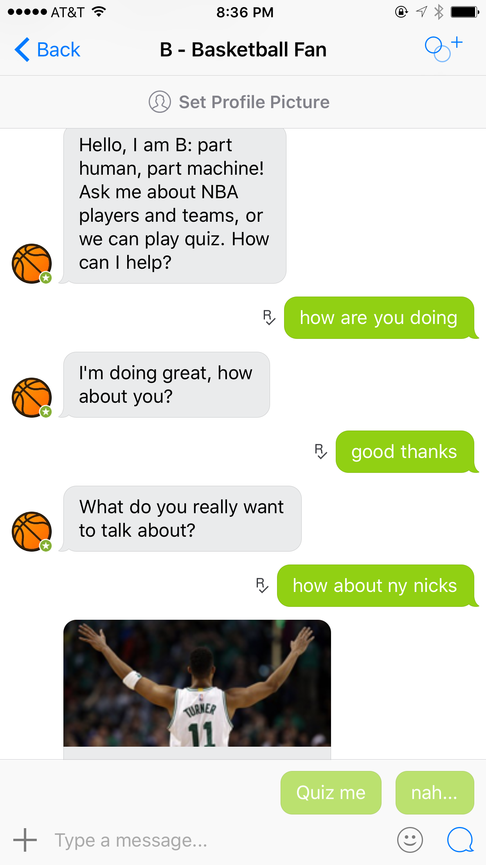
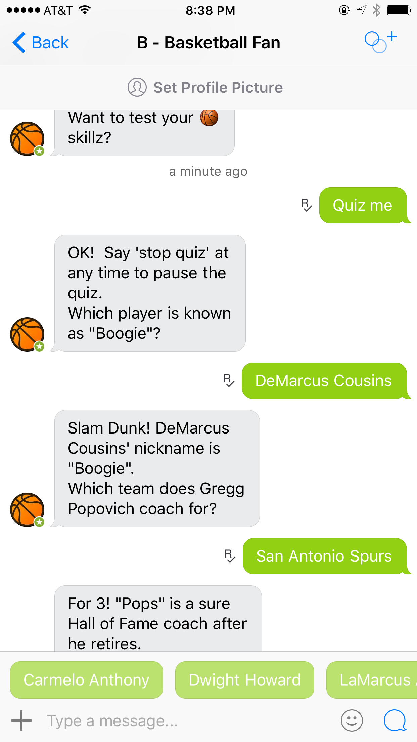
“Chat Bot” as a Service (ongoing)

Slide 22
MapReduce Latent Dirichlet Allocation (WWW 2012)
“I tried both and found that, despite Mr. LDA’s cringeworthy name, it’s much faster than Mahout’s implementation so decided to go with that one.”
Kris Jack, Ph.D., Chief Data Scientist, Mendeley

Slide 23
Non-parametric Bayesian Image Modeling (ICML 2012)

Slide 24
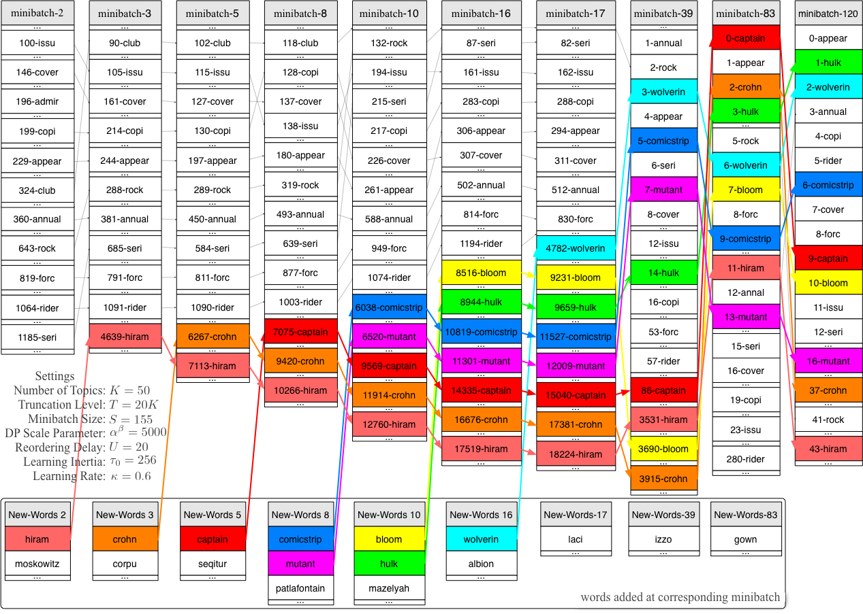
Online LDA with Infinite Vocabulary (ICML 2013)

Slide 25
Online Hybrid Adaptor Grammar (TACL 2014)

Slide 26
Unsupervised Dialogue State Tracking (ACL 2014)

Slide 27
Thank you very much!
Questions?

Slide 28
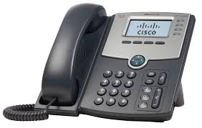
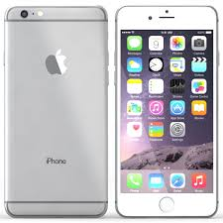
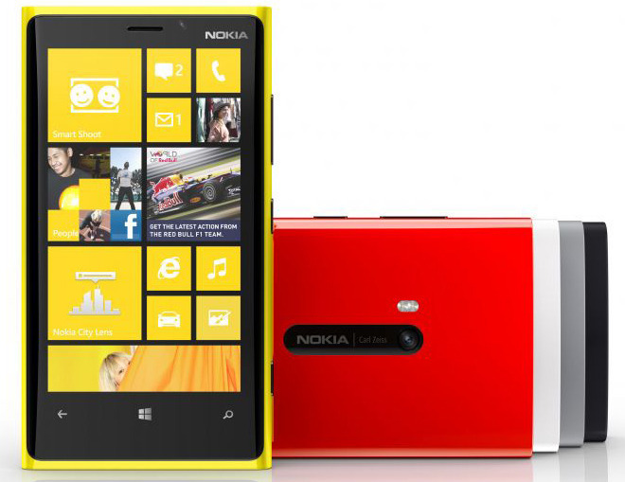
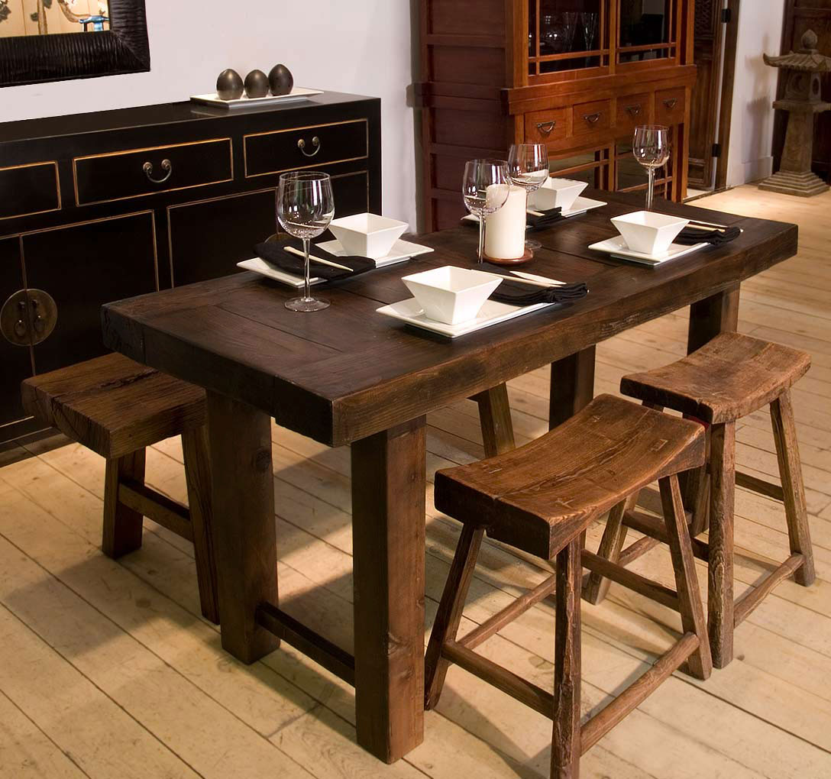
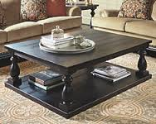
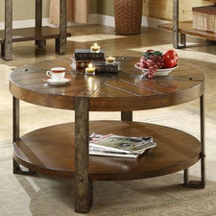
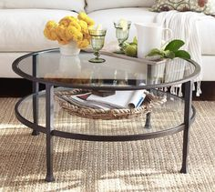
Granularity – All about “Proper” Rules
Product granularity (generic types)
Phone
Smart phone
Android smart phone
…
Table
Coffee table
Round coffee table
Glass round coffee table
…
Notes:
One great advantage using adaptor grammar approach offers a good balance in identifying product granularity in the queries, which often can be a potential problem in human labeling and annotation.
For example, “phone” is obviously a valid product, but how about “smart phone” and “android smart phone”. Would “android smart phone” be too specific?
What about tables? Would “coffee table” be a good level of granularity?
What about “holder”, “paper holder”, “toilet paper holder”?
Adaptor grammar takes good care of this problem, since it determines the granularity level from the probabilistic sense.
If an adapted rule is too conservative, then you need to spend extra efforts every time parsing the query.
If an adapted rule is too aggressive, then you may run into the risk of generating parse tree from scratch on many other instances.
In either case, the adapted rules would converge to a proper granularity.

Slide 29
Query Data
Query Family
Set of queries containing exactly the same bag of words.
Sparse Word Orderings
Query of length n ➔ n! possible word orderings (in theory).
Mostly only one word ordering (in practice).
Otherwise, approximately 90% of them have one predominant word ordering contributes to more than 60% of the total traffic against all possible word orderings.
Non-interleaving Entity Group
Keep the Brand and Product name entities as continuous phrase during search.
Noise may appear within entity group.
Predominant Query Search Pattern
Most frequent query search pattern is <Brand><Product>.
Possibly with additional modifiers and/or prepositional phrase.
neutrogena eye makeup remover | 99.81%
eye makeup remover neutrogena | 0.19%
air optix contact lenses | 98.00%
contact lenses air optix | 1.06%
optix air contact lenses | 0.94%
paul mitchell neuro flat iron | 98.70%
paul mitchell flat iron neuro | 0.65%
neuro paul mitchell flat iron | 0.65%
neutrogena eye makeup remover
eye makeup remover neutrogena
air optix contact lenses
contact lenses air optix
optix air contact lenses
paul mitchell neuro flat iron
paul mitchell flat iron neuro
neuro paul mitchell flat iron
neutrogena eye makeup remover | 99.81%
eye makeup remover neutrogena | 0.19%
air optix contact lenses | 98.00%
contact lenses air optix | 1.06%
optix air contact lenses | 0.94%
paul mitchell neuro flat iron | 98.70%
paul mitchell flat iron neuro | 0.65%
neuro paul mitchell flat iron | 0.65%
Query Length | % of Distinct Word Ordering
 | 1 | 2 | 3 | 4 | 5 | 6
1 | 100.00 | 0.00 | 0.00 | 0.00 | 0.00 | 0.00
2 | 96.16 | 3.84 | 0.00 | 0.00 | 0.00 | 0.00
3 | 94.35 | 5.05 | 0.54 | 0.06 | 0.00 | 0.00
4 | 94.33 | 5.07 | 0.51 | 0.08 | 0.01 | 0.00
5 | 94.98 | 4.53 | 0.39 | 0.08 | 0.01 | 0.00
6 | 96.09 | 3.55 | 0.34 | 0.01 | 0.00 | 0.00
7 | 97.05 | 2.57 | 0.24 | 0.14 | 0.00 | 0.00
8 | 97.63 | 2.09 | 0.28 | 0.00 | 0.00 | 0.00
9 | 96.07 | 3.93 | 0.00 | 0.00 | 0.00 | 0.00
Notes:
To achieve this, we first did some data analysis.
We first define a new concept of query family, which is a set of queries containing exactly the same bag of words.
For example, we find three different query families in this collection of queries, since they share exactly same bag of words.
<Add explanation to the table>
Theoretically, given a query family with n distinct words, there are n! possible word orderings. However, we found that the distribution over all possible word orderings in a query family was extremely sparse.
<Add explanation to the table>
In addition, we found users tend to keep the named entities as continuous phrases.
For instance, they do not interleaving them across each other.
<Add explanation to the table>
Although some noise may appear within each entity group.
<Add explanation to the table>
Moreover, we found the search pattern Brand Product is predominant.

Slide 30
Experiments
Data
Raw queries collected over 9 months
Across five different domains
Baseline
Probabilistic context-free grammar
Same grammars, without adaptors
Semi-supervised method with entity seeds (Pasca, CIKM 2007)
Five seeds per domain per entity
Evaluation metric
Intrinsic evaluation (making sense of the results)
Precision @ Rank
Qualitative results
Extrinsic evaluation (coverage of discovered knowledgebase)
Use discovered knowledgebase as features for external models
Sequence tagging
Query chunking
 | total queries | unique queries | queries after standardization
Apparel | 561M | 906K | 535K
Electronics | 218M | 444K | 160K
Health & Beauty | 222M | 625K | 176K
Home & Garden | 359M | 1068K | 554K
Sporting Goods | 148M | 412K | 206K
Apparel | nike, michael kors, ugg, ray ban, kate spade
 | shoe, dress, handbag, engagement ring, hat
Electronics | samsung, sony, dell, apple, canon
 | printer, tablet, cell phone, remote control, laptop
Health & Beauty | estee lauder, gnc, urban decay, mac, opi
 | supplement, shampoo, nail polish, soap, lipstick
Home & Garden | home depot, john deere, sears, target, lowes
 | lights, chairs, curtains, lamps, pillows
Sporting Goods | under armour, nike, adidas, puma, kappa
 | jacket, bike, pants, socks, helmet

Slide 31
Precision @ Rank

Slide 32
Query Understanding
canon | hd | digital | camera
B-Brand | O | B-Product | I-Product
sally | hansen | miracle | gel
B-Brand | I-Brand | B-Product | I-Product
paul | mitchell | neuro | flat | iron
B-Brand | I-Brand | O | B-Product | I-Product
zoku | mini | ice | cream | maker
B-Brand | O | B-Product | I-Product | I-Product
weed | eater | lawn | mowers | at | walmart
B-Brand | I-Brand | B-Product | I-Product | O | O
mi | zone | katelyn | coral | teen | comforter | set
B-Brand | I-Brand | O | O | O | B-Product | I-Product

Slide 33
Adaptor Grammar
Query
Brand
Words
Word
pottery
Words
Word
barn
Product
Words
Word
paper
Words
Word
towel
Words
Word
holder
Prob | Rule
1.0 | Query → Brand Product
1.0 | Brand → Words
1.0 | Product → Words
0.7 | Words → Word Words
0.3 | Words → Word
0.1 | Word → pottery
0.1 | Word → barn
0.2 | Word → coffee
0.2 | Word → table
 | …
Prob | Rule
1.0 | Query → Brand Product
0.81 | Brand → Words
0.75 | Product → Words
0.7 | Words → Word Words
0.3 | Words → Word
0.1 | Word → pottery
0.1 | Word → barn
0.2 | Word → coffee
0.2 | Word → table
 | …
0.19 | Brand → pottery barn
0.25 | Product → coffee table
Query
Brand
Words
Word
crate
Words
Word
Product
Words
Word
coffee
Words
Word
table
and
Words
Word
barrel

